Slide 1



Oman Investment & Finance Co. SAOG
OVER 40 YEARS IN SERVICE
MSX Investor Roadshow 2022

Slide 2
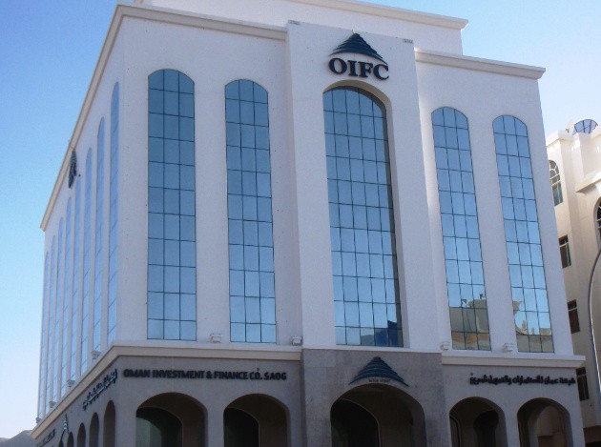


About Us
857 Employees 94% Omanization
Branch Network
68 Branches
Established in 1979

Slide 3
Our Major Shareholders
42.43%
37.97%
7.6%
12%
Oman Investment Authority (OIA)
Dhofar International Development & Investment Holding Co. SAOG (DIDIC)
Muscat Overseas
Total Number of Investors = 2,204

Slide 4
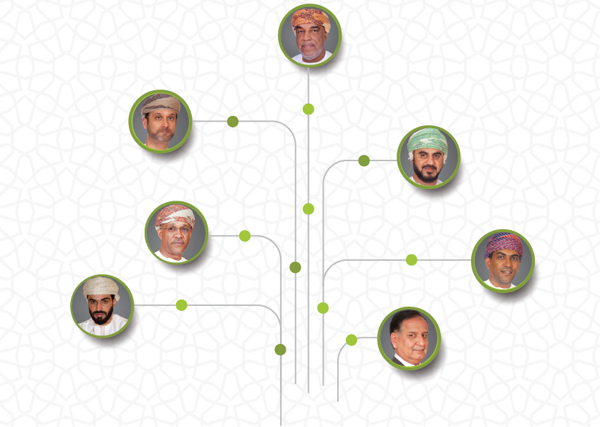
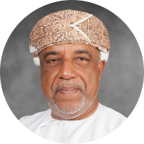
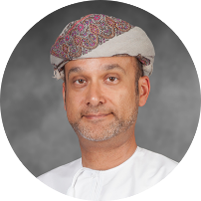
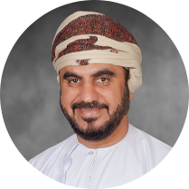
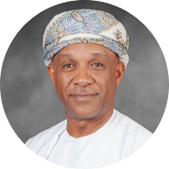
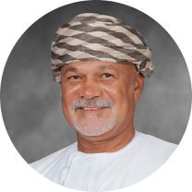
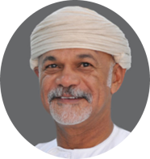
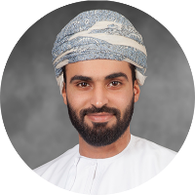
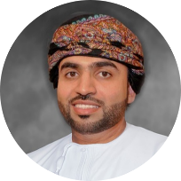
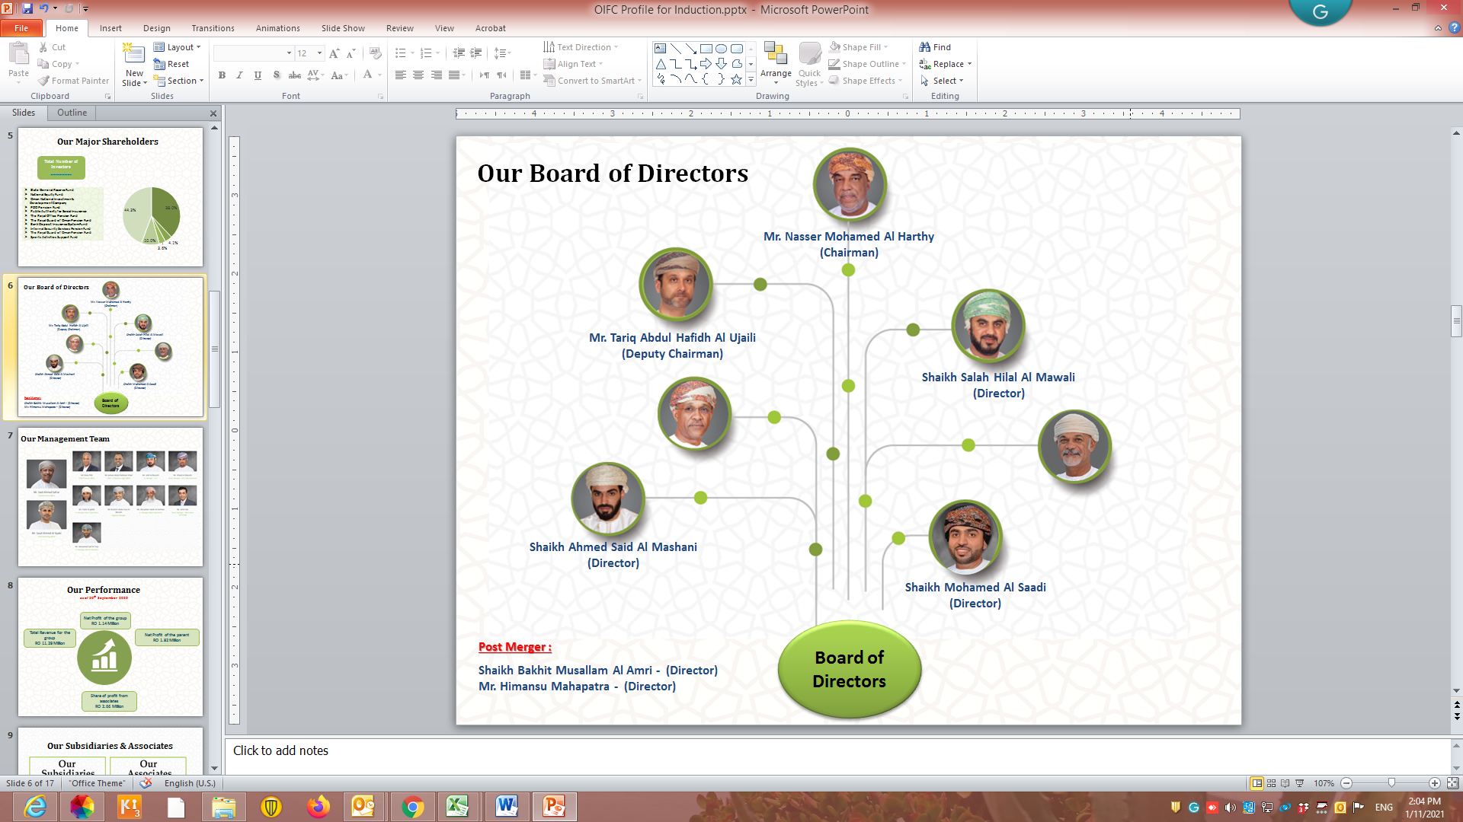
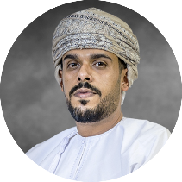
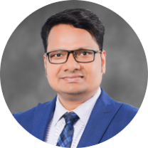
Our Board of Directors
Mr. Nasser Mohamed Al Harthy
Chairman
Mr. Tariq Abdul Hafidh Al Aujaili
Deputy Chairman
Shaikh Salah Hilal Al Mawali
Director
Mr. Majid Sultan Al Toky
Director
Mr. Ahmed Mohamed Al Abri
Director
Shaikh Ahmed Said Al Mashani
Director
Board of Directors
Shaikh Mohamed Salim Al Saadi
Director
Shaikh Bakhit Musallam Al Amri
Director
Mr. Himansu Mahapatra
Director

Slide 5
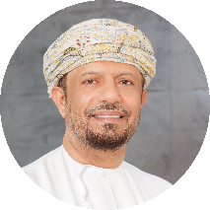
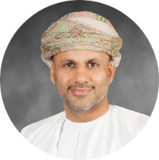
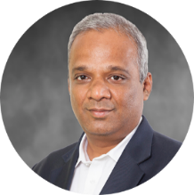
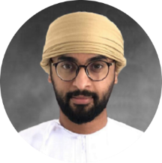
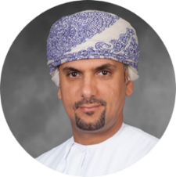
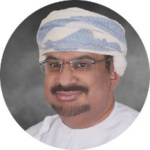
Our Management Team
Mr. Said Ahmed Safrar
Chief Executive Officer
Mr. Saud Ahmed Al Siyabi
Chief Operating Officer
Mr. Vikas Pitti
Chief Financial Officer
Mr. Faris Mohamed Al Sharji
Head of Internal Audit
Management Team
Mr. Khalid Kahoor Al Balushi
Sr. Manager – H.R. & Admin
Mr. Qais Abdullah Al Yarubi
Head of Compliance & Legal Affairs

Slide 6
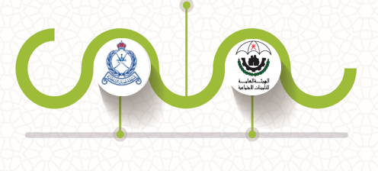
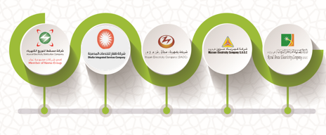
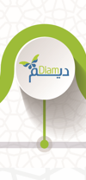


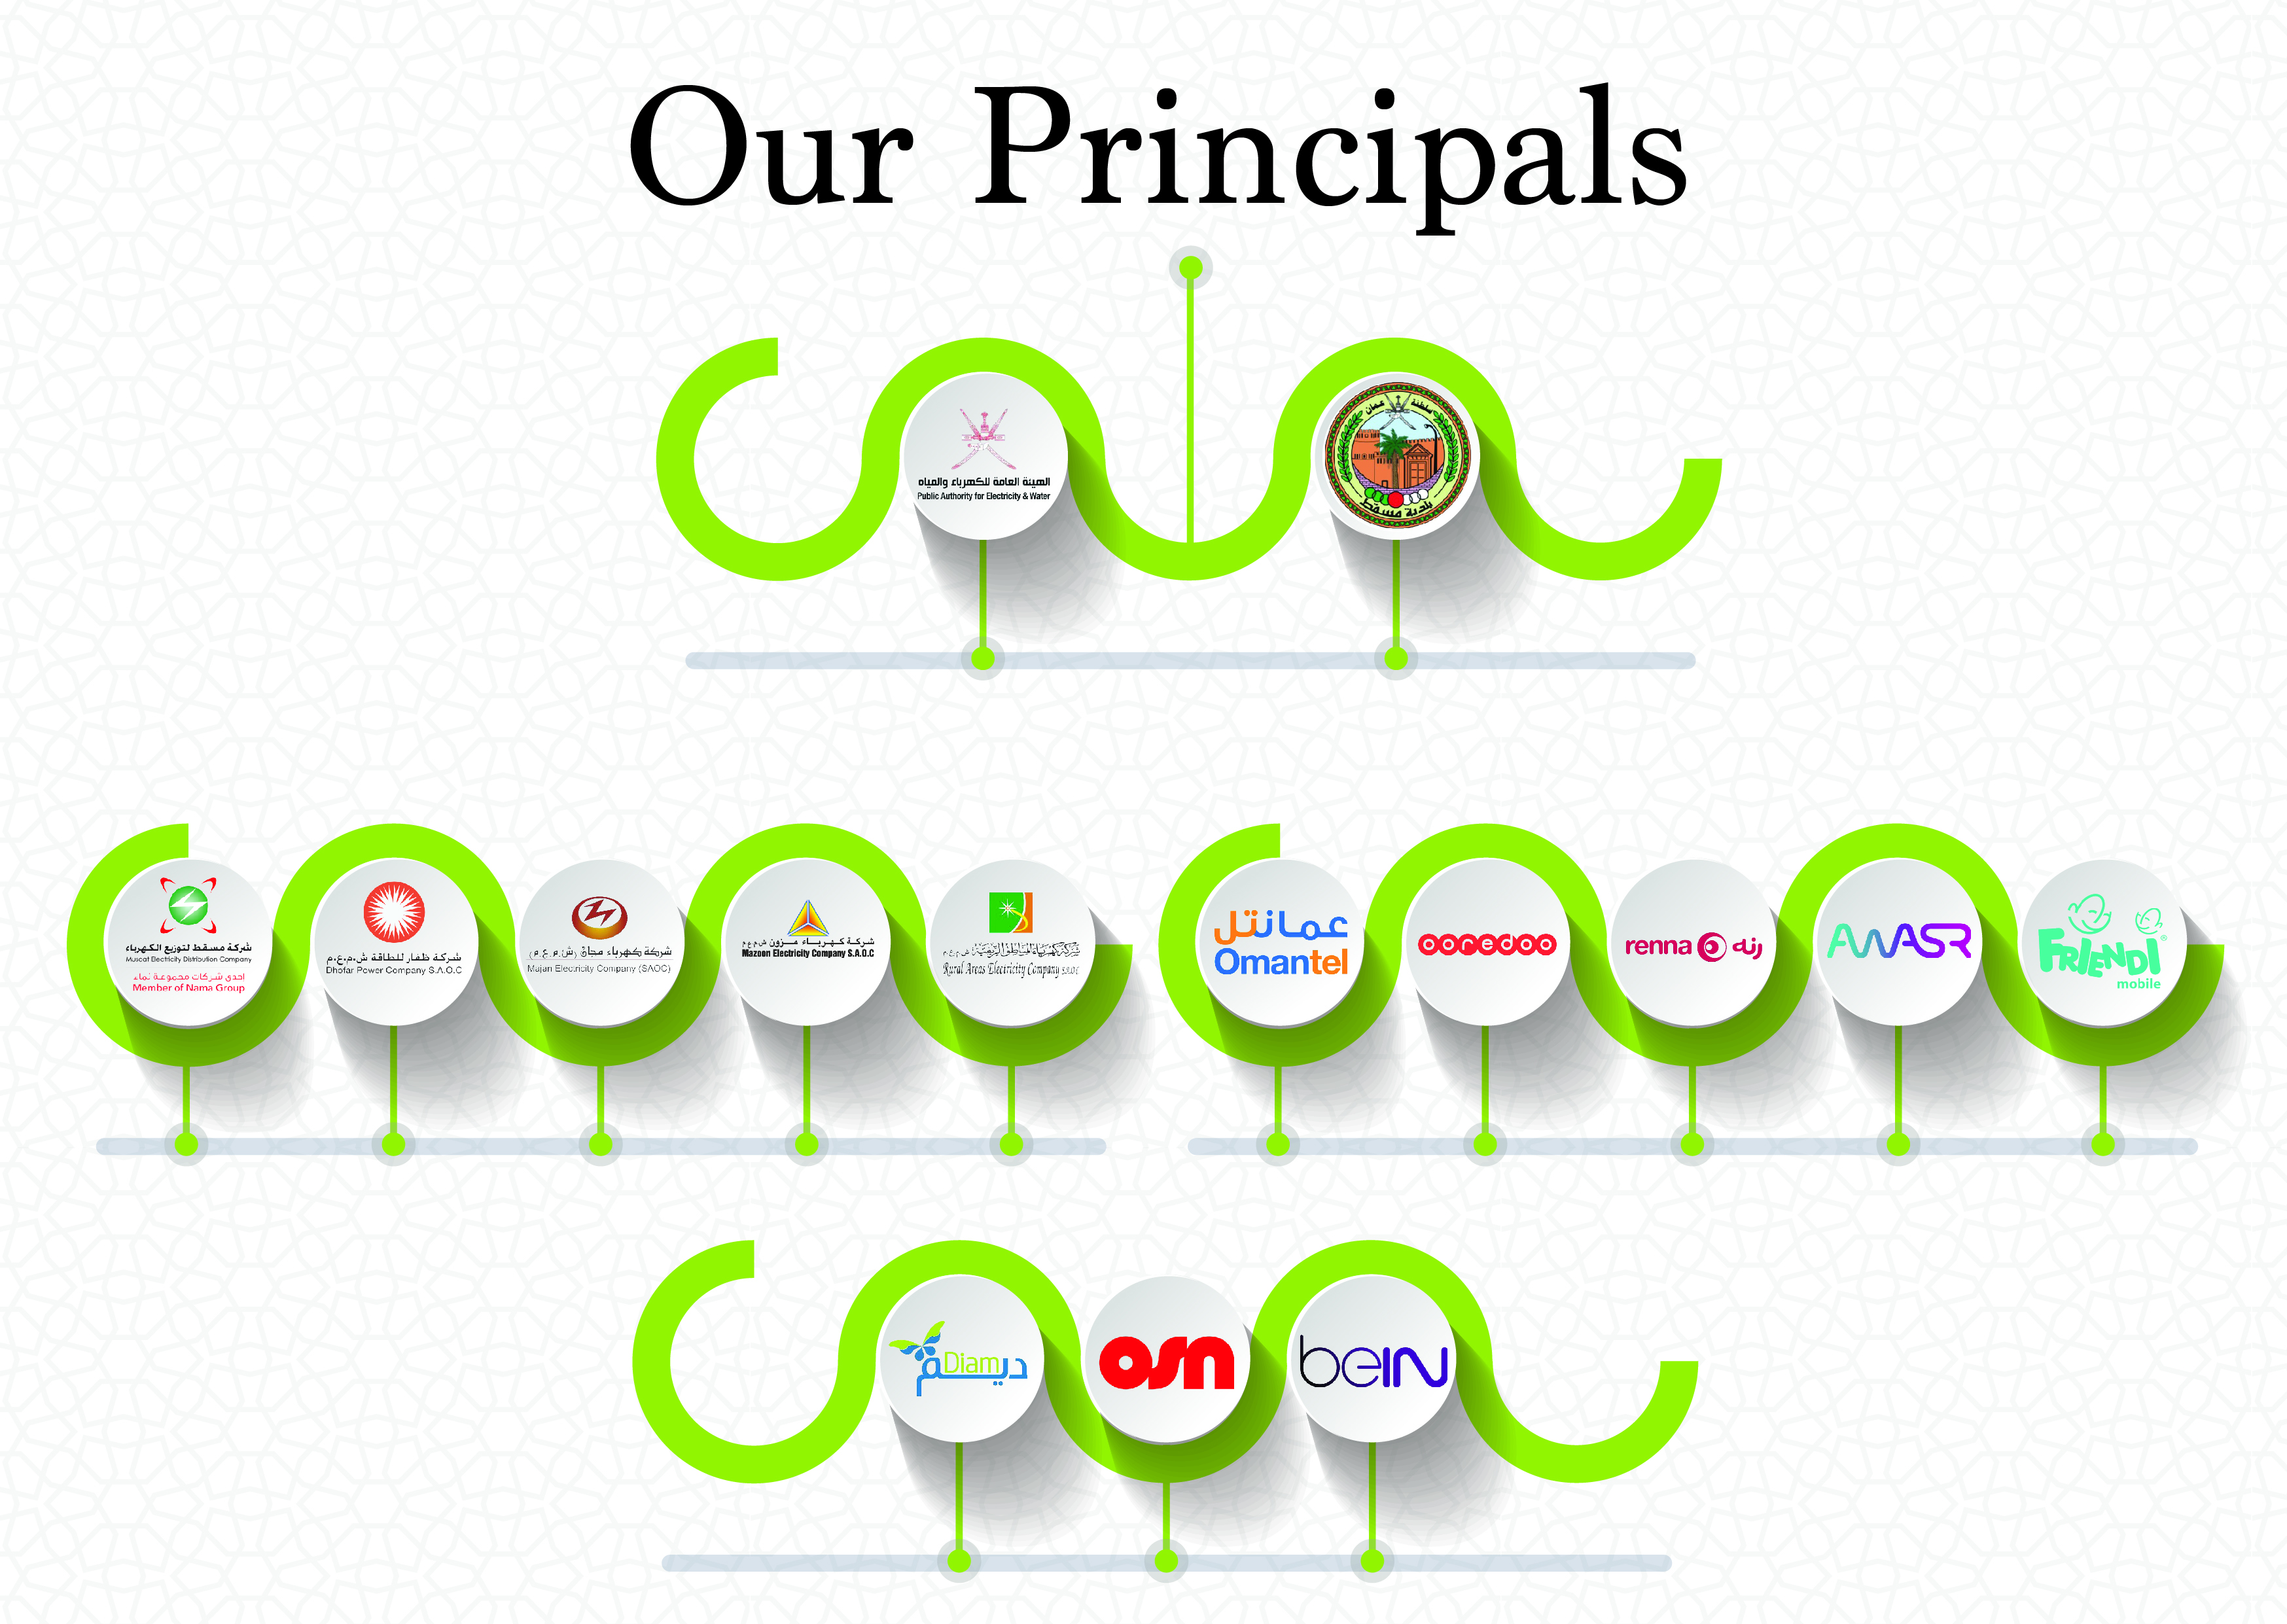

Our Principals
More than 15 service providers

Slide 7
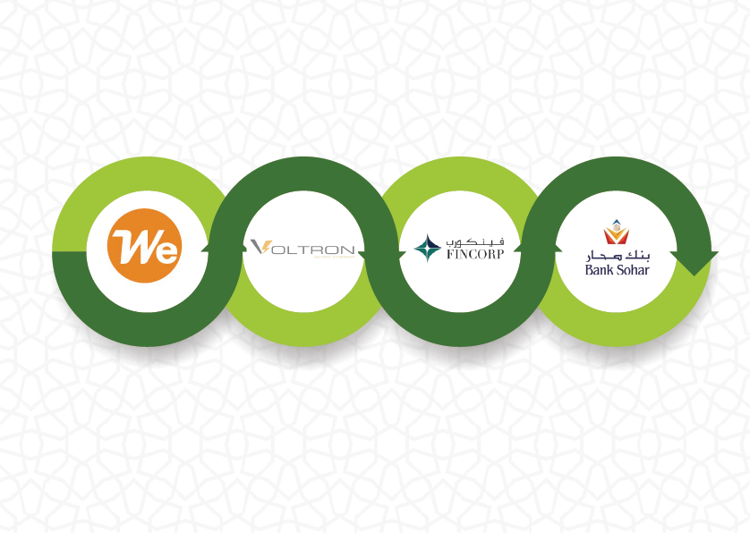


Subsidiaries
Our Investments:
Associates
100%
92%
21.8%
15.42%

Slide 8





Our Operation – 5 Payment Channels
54
Bill Payment Machines
Khedmah Kiosks
Branch Network
Web Portal
Payment Channels
4
64
Mobile App
21 branches

Slide 9
OIFC Digitizing Services
2010
2012
Self Service - Bill payment machines - Cash
Online Integration with banks for payments
2016
Mobile Application launched ~ 700k App Downloads of user base as of June’22
2017
Collection through Web Portal launched
2014
Enabled POS transactions across all branches
2019
Launched Electricity Prepaid Recharge Service across Oman
2022
Tanker Management System for Haya DIAM
2020
Collection Services for PASI
2021
Collection services for Motor vehicle insurance renewal
2022
Collection Services for ROP

Slide 10
Share of Digital Payments
Transactions Count in 000
*Upto August 2022

Slide 11
Diversified Revenue Streams
Group
Collection Revenue Debt Recovery Utilities Operation
EPC Money Exchange
Share of B2C segment (Collection + Money Exchange + Debts Recovery)
improved substantially – 36% to 51%
Share of Collection Revenue increased - 26% to 40%
Dependency on Utilities Operation reduce - 39% to 23%

Slide 12
OIFC Group H1 Revenue Trends
RO in 000
Revenue CAGR for last five years : Parent 5.6%, Group 1.6%

Slide 13
Income from Associates H1 Trend
RO in 000
Investments | 2018 | 2019 | 2020 | 2021 | 2022
Sohar Intl Bank | 2,162 | 2,856 | 2,026 | 2,344 | 2,849
Fincorp | 36 | 64 | (163) | 156 | (53)
Total | 2,198 | 2,920 | 1,863 | 2,500 | 2,796

Slide 14
OIFC Group H1 Net Profit –Trends
RO in 000
Net Profit CAGR growth rate of last five year for : Parent 14.8%, Group 48.3%

Slide 15
Key Market Indicators
Highlights
Consistent performance Vs leading companies in financial and investment sector
Price to Book Value 80%- 130%
Average ROE 9%-11.5%
Average Dividend Yield 6.8%-8.6%
Volume Traded on MSM > 100% of No of shares outstanding

Slide 16
Key Market Indicators
Dividend Yield – Calculated on average of market price at the beginning and end of the year

Slide 17
Future Outlook
Revenue diversification
Sustainable revenue growth
Improving margin
Successfully transformed operation
Leading Digital service platform
Focus on Human resources alignment
Explore new investments opportunities

Slide 18


Slide 19



